Slide 1
Agile Methodology and Scrum
- Tasneem Bunglowala

Slide 2
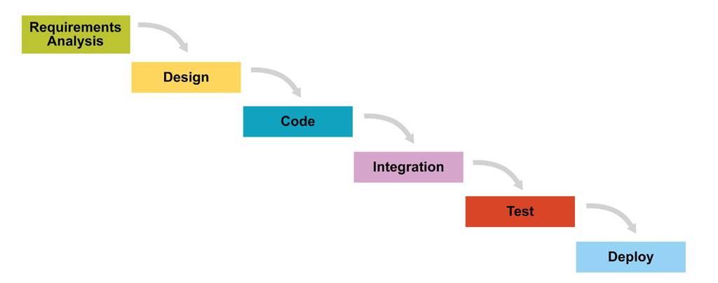
Traditional Waterfall Methodology

Slide 3
What is Agile?
Agile methodology is an alternative to traditional project management, typically used in software development.
It helps teams respond to unpredictability through incremental, iterative work cadences, known as sprints.
Agile methodologies are an alternative to waterfall, or traditional sequential development.
The incremental, iterative approach trades the traditional phases of “waterfall” development for the ability to develop a subset of high-value features first, incorporating feedback sooner.

Slide 4
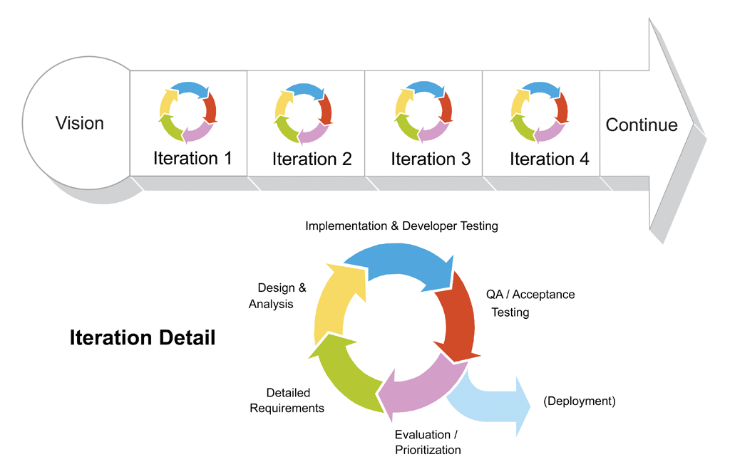

Slide 5
What is Scrum?
Scrum is a management framework for incremental product development using one or more cross-functional, self-organizing teams of about seven people each.
Scrum emphasizes collaboration, functioning software, team self management, and the flexibility to adapt to emerging business realities.
It provides a structure of roles, meetings, rules, and artifacts. Teams are responsible for creating and adapting their processes within this framework.
Scrum uses fixed-length iterations, called Sprints, which are typically 1-2 weeks long (never more than 30 days). Scrum teams attempt to build a potentially shippable (properly tested) product increment every iteration.

Slide 6
Scrum Roles
Product Owner: The Product Owner should be a person with vision, authority, and availability. The Product Owner is responsible for continuously communicating the vision and priorities to the development team.
Scrum Master: The Scrum Master acts as a facilitator for the Product Owner and the team. The Scrum Master does not manage the team. The Scrum Master works to remove any impediments that are obstructing the team from achieving its sprint goals.
Team: According to Scrum philosophy, “the team is utterly self managing.” The development team is responsible for self organizing to complete work. A Scrum development team contains about seven fully dedicated members (officially 3-9), ideally in one team room protected from outside distractions. For software projects, a typical team includes a mix of software engineers, architects, programmers, analysts, QA experts, testers, and UI designers. Each sprint, the team is responsible for determining how it will accomplish the work to be completed. The team has autonomy and responsibility to meet the goals of the sprint.

Slide 7
Product Owner
Single person responsible for maximizing the return on investment (ROI) of the development effort
Responsible for product vision
Constantly re-prioritizes the Product Backlog, adjusting any longterm expectations such as release plans
Final arbiter of requirements questions
Accepts or rejects each product increment
Decides whether to ship
Decides whether to continue development
Considers stakeholder interests
May contribute as a team member

Slide 8
Scrum Master
Facilitates the Scrum process
Helps resolve impediments
Creates an environment conducive to team self-organization
Captures empirical data to adjust forecasts
Shields the team from external interference and distractions to keep it in group flow (a.k.a. the zone)
Enforces timeboxes
Keeps Scrum artifacts visible
Promotes improved engineering practices
Has no management authority over the team (anyone with authority over the team is by definition not its ScrumMaster)
Not a coordinator

Slide 9
Scrum Development Team
Cross-functional (e.g., includes members with testing skills, and often others not traditionally called developers: business analysts, domain experts, etc.) Self-organizing / self-managing, without externally assigned roles
Negotiates commitments with the Product Owner, one Sprint at a time
Has autonomy regarding how to reach commitments
Intensely collaborative
Most successful when located in one team room, particularly for the first few Sprints
Most successful with long-term, full-time membership. Scrum moves work to a flexible learning team and avoids moving people or splitting them between teams.
3-9 members (originally 7 ± 2 members)

Slide 10
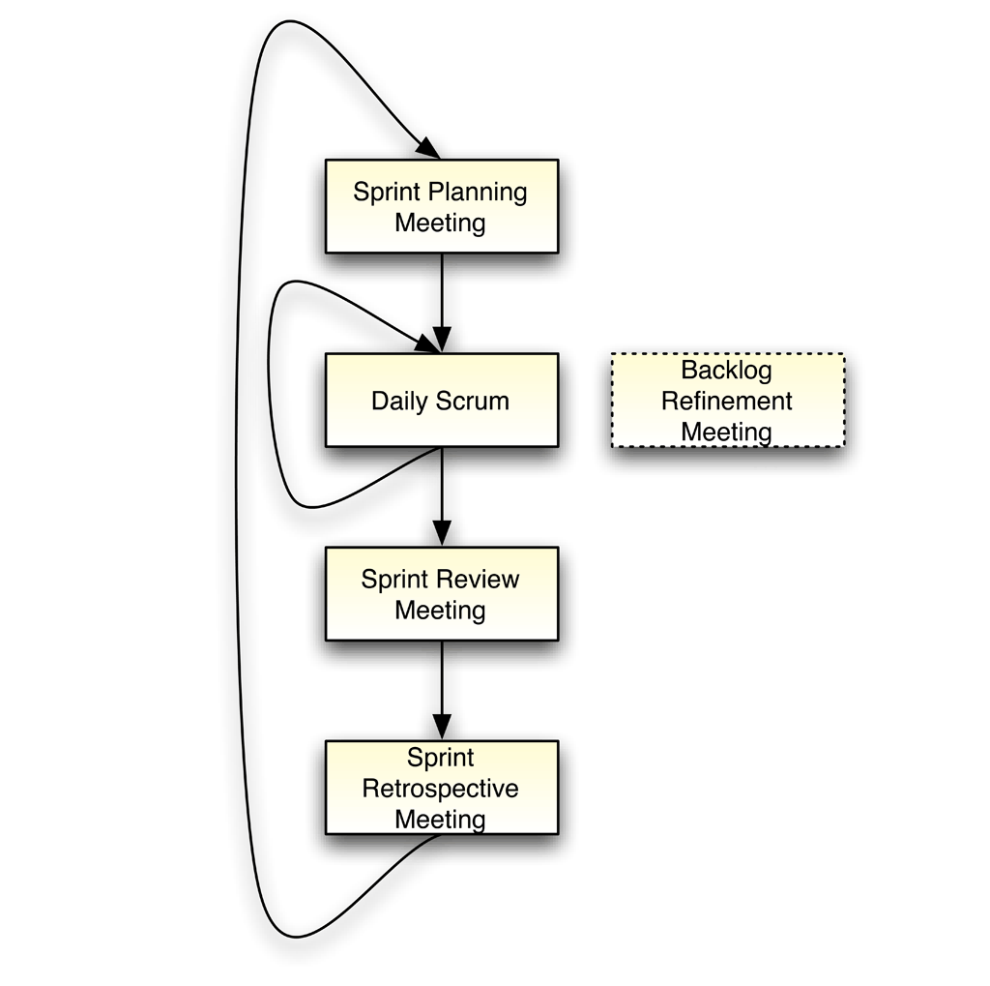
Scrum Meetings
All Scrum Meetings are facilitated by the ScrumMaster, who has no decision-making authority at these meetings.

Slide 11
Sprint Planning Meeting
At the beginning of each Sprint, the Product Owner and team hold a Sprint Planning Meeting to negotiate which Product Backlog Items they will attempt to convert to working product during the Sprint.
The Product Owner is responsible for declaring which items are the most important to the business.
The team is responsible for selecting the amount of work they feel they can implement without accruing technical debt.
The team “pulls” work from the Product Backlog to the Sprint Backlog.
Toward the end of the Sprint Planning Meeting, the team breaks the selected items into an initial list of Sprint Tasks, and makes a final commitment to do the work.

Slide 12
Daily Scrum
Every day at the same time and place, the Scrum Development Team members spend a total of 15 minutes reporting to each other. Each team member summarizes what he did the previous day, what he will do today, and what impediments he faces.
Standing up at the Daily Scrum will help keep it short. Topics that require additional attention may be discussed by whomever is interested after every team member has reported.
The team may find it useful to maintain a current Sprint Task List, a Sprint Burndown Chart, and an Impediments List. During Sprint execution it is common to discover additional tasks necessary to achieve the Sprint goals. Impediments caused by issues beyond the team’s control are considered organizational impediments.

Slide 13
Sprint Review Meeting (Show & Tell)
After Sprint execution, the team holds a Sprint Review Meeting to demonstrate a working product increment to the Product Owner and everyone else who is interested.
The meeting should feature a live demonstration, not a report.
After the demonstration, the Product Owner reviews the commitments made at the Sprint Planning Meeting and declares which items he now considers done. For example, a software item that is merely “code complete” is considered not done, because untested software isn’t shippable. Incomplete items are returned to the Product Backlog and ranked according to the Product Owner’s revised priorities as candidates for future Sprints.
The ScrumMaster helps the Product Owner and stakeholders convert their feedback to new Product Backlog Items for prioritization by the Product Owner. Often, new scope discovery outpaces the team’s rate of development. If the Product Owner feels that the newly discovered scope is more important than the original expectations, new scope displaces old scope in the Product Backlog.

Slide 14
Sprint Retrospective Meeting
Each Sprint ends with a retrospective. At this meeting, the team reflects on its own process. They inspect their behavior and take action to adapt it for future Sprints.
Dedicated ScrumMasters will find alternatives to the stale, fearful meetings everyone has come to expect. An in-depth retrospective requires an environment of psychological safety not found in most organizations. Without safety, the retrospective discussion will either avoid the uncomfortable issues or deteriorate into blaming and hostility.
A common impediment to full transparency on the team is the presence of people who conduct performance appraisals.

Slide 15
Backlog Refinement Meeting
Most Product Backlog Items (PBIs) initially need refinement because they are too large and poorly understood. Teams have found it useful to take a little time out of Sprint Execution — every Sprint — to help prepare the Product Backlog for the next Sprint Planning Meeting.
In the Backlog Refinement Meeting, the team considers the effort they would expend to complete items in the Product Backlog and provides other technical information to help the Product Owner prioritize them. (3) Large vague items are split and clarified, considering both business and technical concerns. Sometimes a subset of the team, in conjunction with the Product Owner and other stakeholders, will compose and split Product Backlog Items before involving the entire team in estimation.

Slide 16
Scrum Artifacts
Product Backlog : List of desired functionality
Product Backlog Item : What, User Story
Sprint Backlog : Committed PBI
Sprint Backlog : How

Slide 17
Product Backlog
Force-ranked list of desired functionality
Visible to all stakeholders
Any stakeholder (including the Team) can add items
Constantly re-prioritized by the Product Owner
Items at top are more granular than items at bottom
Maintained during the Backlog Refinement Meeting

Slide 18
Product Backlog Item
Specifies the what more than the how of a customer-centric feature
Often written in User Story form
Has a product-wide definition of done to prevent technical debt
May have item-specific acceptance criteria
Effort is estimated by the team, ideally in relative units (e.g., story points)
Effort is roughly 2-3 people 2-3 days, or smaller for advanced teams

Slide 19
Sprint Backlog
Consists of committed PBIs negotiated between the team and the Product Owner during the Sprint Planning Meeting
Scope commitment is fixed during Sprint Execution
Initial tasks are identified by the team during Sprint Planning Meeting
Team will discover additional tasks needed to meet the fixed scope commitment during Sprint execution
Visible to the team
Referenced during the Daily Scrum Meeting

Slide 20
Sprint Task
Specifies how to achieve the PBI’s what
Requires one day or less of work
Remaining effort is re-estimated daily, typically in hours
During Sprint Execution, a point person may volunteer to be primarily responsible for a task
Owned by the entire team; collaboration is expected

Slide 21
References
http://scrummethodology.com
http://agilemethodology.org
https://en.wikipedia.org/wiki/Scrum_(software_development)
https://www.mountaingoatsoftware.com/agile/scrum

